Slide 1


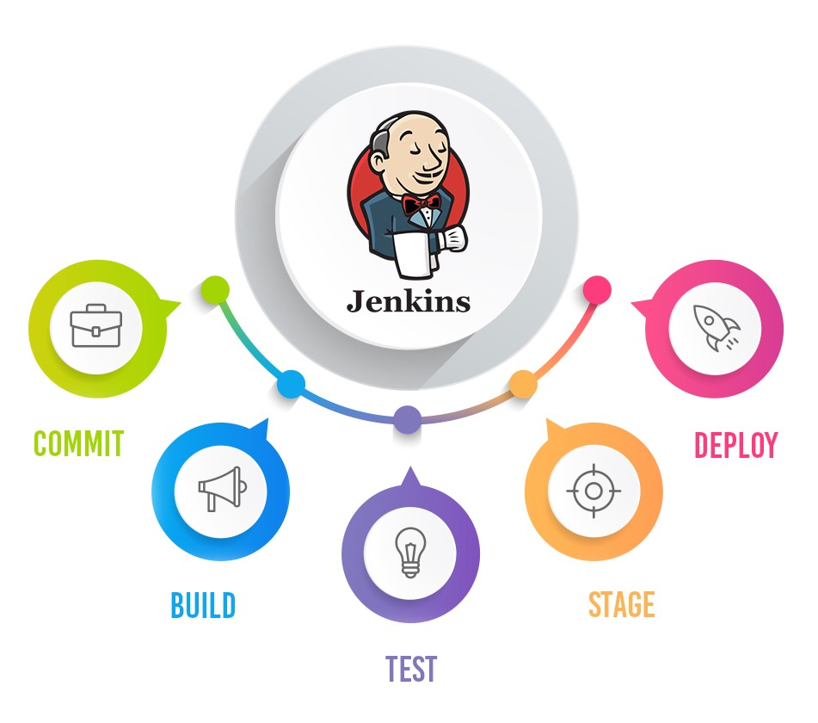
Jenkins Mastery for Software Tester
Pramod Dutta
Jenkins CLI - Do everything using CMD

Slide 2

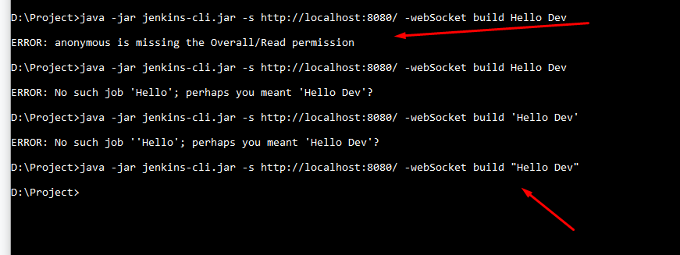
What we need to Do?
Build job and Create Job with CMD
http://localhost:8080/cli/
Jenkins has a built-in command line interface that allows users and administrators to access Jenkins from a script or shell environment

Slide 3
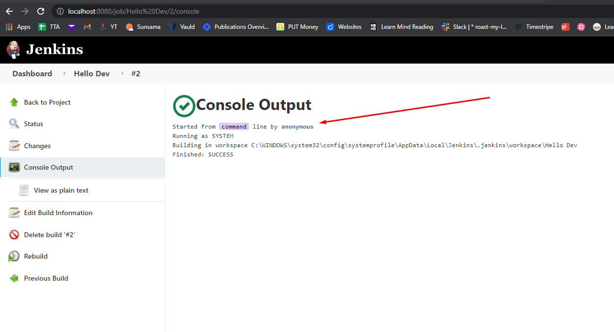
What we need to Do?
Build job and Create Job with CMD
Jenkins has a built-in command line interface that allows users and administrators to access Jenkins from a script or shell environment

Slide 4
What we need to Do?
USER:TOKEN
111322533695625987547acbdc9824adbf - http://localhost:8080/user/admin2/configure
https://www.jenkins.io/doc/book/managing/cli/
java -jar jenkins-cli.jar -s http://localhost:8080/ -webSocket -auth USER:111322533695625987547acbdc9824adbfcreate -job CLI.

